Slide 1
Representing Knowledge

Slide 2
We talk about the knowledge
Knowledge as a proposition:
  We often say, “John knows that …”
  The ... is replaced with a proposition: a statement that can be true or false.
    Example: “John knows that Rome is the capital of Italy.”
    “John knows that it will rain” and “John fears that it will rain” refer to the same content but express different attitudes. Knowing involves accepting something as true, whereas fearing involves an emotional response to it.
Other forms of knowledge:
  Knowing how (procedural knowledge): having a skill, such as building something.
  Knowing who, what, or when (factual knowledge): having factual or identifying information.
  Sensorimotor knowledge: practical abilities involving perception and movement.
  Affective knowledge: a deep, often experiential understanding of something.

Slide 3
We talk about the knowledge
Knowledge vs. Belief:​
A belief is not necessarily true, and it may not be supported by appropriate reasons.​
For example:​
  John might believe that it will rain, but his belief could be mistaken.​
  “John suspects that …” expresses an even weaker commitment than belief.​
Knowledge is a way of taking the world to be a certain way, but not every belief or attitude counts as knowledge. We need (often) truth, belief, and justification.

Slide 4
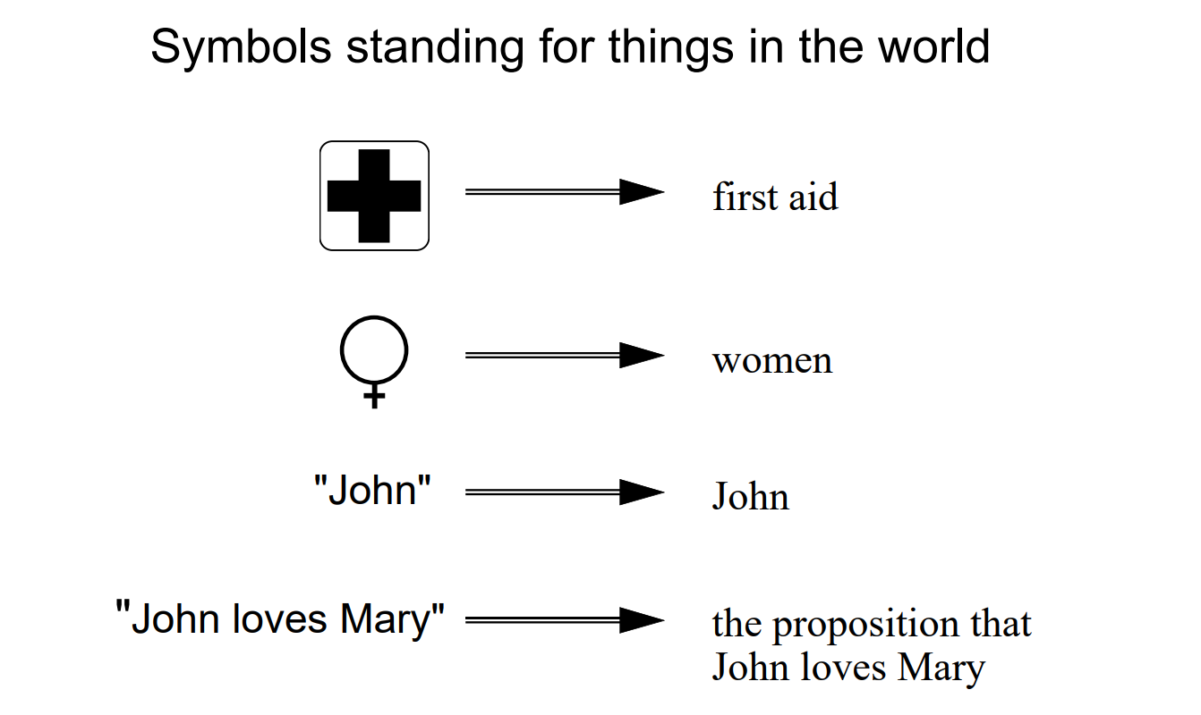
Representing Knowledge
Knowledge representation: symbolic encoding of propositions believed (by some agents)
Reasoning is the manipulation of these propositions to produce representations of new propositions​

Slide 5
Representing Knowledge
Brachman’s theory of knowledge representation (1979)​
Ronald J. Brachman’s work addresses a fundamental question:
How can we represent knowledge so that a computer can store it, interpret it, reason with it, and use it to solve problems?​
Knowledge representation systems can be seen through different levels of abstraction, involving several distinct choices.
How many/which levels?

Slide 6
Representing Knowledge
Brachman (1979) defines five levels of knowledge representation:​
1. Implementation level
2. Logical level
3. Epistemological level
4. Conceptual level
5. Linguistic level

Slide 7
Representing Knowledge
Brachman (1979) defines five levels of knowledge representation:
Implementation level: how knowledge is encoded by a computer, including data-structure. Example: database or XML files.
Logical level: how knowledge is expressed using formal logic, facts, and rules. Example: Description Logics or LPG and Graph Traversal algorithms.
Epistemological level: how knowledge is structured into primitives such as concept types and structural relations. Example: Dog is a label, has_name is a property.
Conceptual level: how to uses the primitives defined at the epistemological level to describe the entities in a domain. Example: Fuffy is a Dog. Fuffy has_name ‘Fuffy’
Linguistic level: the linguistic level concerns how knowledge is expressed through language. Example: Cypher.

Slide 8
Representing Knowledge
Level | Language | Primitives
Implementation level | A serialization format | Symbols of the language
Logical level | A logical formalism | Logical predicates, operators, quantifiers
Epistemological level | An ontology language | Definition of concept and slot types, structuring relationships like inheritance
Conceptual level | An ontology | Concepts and their relationships
Linguistic level | Natural language | The primitives provided by a natural language, such as words, sentences, punctuation

